Slide 1
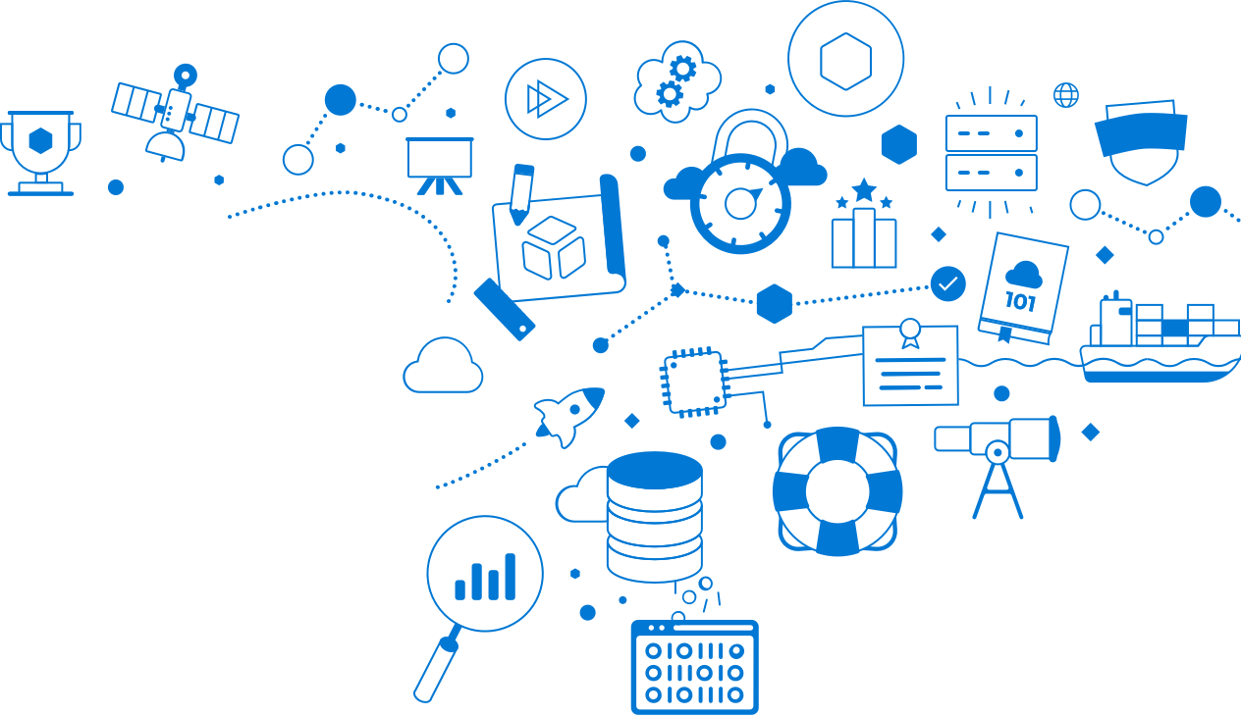
Microsoft Learn – Free!
New !
Build your skills fast with free, interactive tutorials at
Microsoft Learn, a new training experience for technical users.
Step-by-step training to fit your schedule
Interactive coding environments for hands-on experience
Earn achievements and recognition for your Azure skills
Start today at Microsoft.com/Learn
Notes:
pppIntroducing Microsoft Learn – the Best place to start learning Microsoft technologies – Free!
Quickly build skills: interactive, step-by-step bite-size tutorials
Learn by doing: browser-based interactive coding environments for hands-on experience. Free fixed-time access to create and manage Azure resources - no credit card required.
Earn recognition: Track progress, check knowledge, and validate deployments to earn points, levels, achievements, and trophies
Learning aligned to new role-based certifications: easier for you to prepare for certification and be recognized as a leader in Microsoft technologies
Multiple modes of learning: learn in way best for you. select from free self-paced quick tutorials and hands-on learning, to structured online courses free from Pluralsight and instructor led classes from learning partners.
Slide 2: animated learning Experience
This is just the beginning of our investment in building a learning experience to help our customers and partners build the skills in Microsoft technologies.
Today we have Over 60+ hours of learning content for Azure, Dynamics, and Power BI; and we will continue to building on this content and add additional Microsoft technologies to this experience
Visit our Microsoft Learn booth to experience our new learning platform and get insights from our experts on the best way to begin building Microsoft skills. Earn SWAG !
Visit microsoft.com/learn to begin building learning!
Background:
New role-based certifications!
Announcing new role-based certifications! Today we are releasing 3 new Azure role-based certifications her at Ignite:
Microsoft Certified Azure Administrator,
Microsoft Certified Azure Developer and
Microsoft Certified Azure Solutions Architect
Learning content across modalities including from Microsoft Learning Partners will align to the new role-based certifications to make it easier for you to prepare for certification and be recognized as a leader in Microsoft technologies

Slide 2
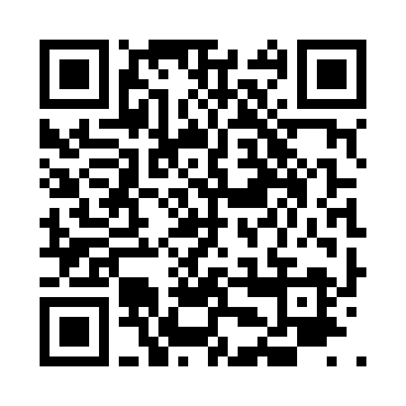
Azure IoT Overview
Dave Glover, Microsoft Cloud Advocate
@dglover
Microsoft Docs and Microsoft Learn
Notes:
Welcome to connected world, that becomes more connected every day. Let’s talk about ways you can capture the benefits of this connectivity for your business with the Internet of Things.

Slide 3
Waves of Innovation driving IoT
Cloud
Globally available, unlimited compute resources
IoT
Harnessing signals from sensors and devices, managed centrally by the cloud
Edge
Intelligence offloaded from the cloud to IoT devices
AI
Breakthrough intelligence capabilities, in the cloud and on the edge

Slide 4

THE DIGITAL FEEDBACK LOOPS
Our vision: to enable any organization to create digital feedback loops for all aspects of their business
Empowered
PEOPLE
Engaged
Transformed
DATA
CUSTOMERS
INTELLIGENCE
PRODUCTS
Optimized
OPERATIONS
Notes:
As customer strive to take advantage of the digital transformation that is occurring in virtually every industry, they need to re-evaluate how they engage with their customers/prospects, how they transform their products and operations, and how they empower and understand their employees.
In today’s world, doing each of these things is more and more reliant upon data…traditionally, everything you knew about your customers and prospects was available in your business application systems and in the heads of employees. You learned almost everything about your products BEFORE they left your warehouse. Employees used technology more to enter data than to learn from it.
In the data-driven world we live in today, leveraging intelligent insights from data across customers, products, and employees is critical to be able to stay competitive and keep up with or lead digital transformation in any industry. And this isn’t just a customer’s typical business application data – it’s also about augmenting the customer’s data with additional data (e.g. search, employee behavioral data, sentiment data, benchmark data, etc) – and applying the right intelligence to drive meaningful insights.
Let’s take a look at how this might help businesses(next slide – top of mind)
_______________________________
ORIGINAL TALKING POINTS:
The lower left-hand side customers. If you think about -- and this is sort of traditionally the domain of CRM, customer engagement. If you think about CRM traditionally, it was a system largely about the "known knowns." You know, you were in my CRM system if I knew your name, maybe had some contact information.
But, increasingly, our customers -- or even our prospects before they are customers -- are showing up to us in anonymous form first. They're a profile on the other side of a Web session, some random Twitter handle tweeting about my brand, and they're coming at me from all of these various channels that are digitally delivered. And that allows our customers, and in many ways mandates that our customers think differently about how they engage their customers. Collecting all of this information from these various sources, even prior to knowing who this individual is or being able to identify them, and being able to sort of take them on a journey intelligently based on these learnings. That's a fundamental change in the way that we're engaging our customers.
On the right-hand side at the bottom, products. I would argue this is the traditional ERP environment, where traditionally ERP was about collecting supply chain, manufacturing some products, warehousing them, shipping them out, hopefully getting paid. But once the product left the loading docks, hit the truck, it was gone.
Today, that is increasingly not the case. When I ship a product to a customer, that product is often connected back. It's sending lots of telemetry, and it's allowing me to rethink fundamentally the nature of the products and services. And it has huge implications for what's possible.
Think about manufacturing defects or quality, being able to assess your posture as a result of real data for real customer use.
Watching the use of consumables, doing a better job of planning inventory. Predicting when a piece of capital equipment is going to fail, and then proactively managing it, versus allowing the customer to get into a situation of dissatisfaction. Again, fundamental reimagination of what's possible on the product side.
And these two things are inextricably linked. And I'm learning something about my customers I never could if I can observe their use of my products and services, I can feed that right back into the customer engagement cycle. I can recommend new products and services.
So this sort of interconnected set of business processes is brand new, powered by data, artificial intelligence, and as we'll talk, delivered through Dynamics 365.
But this last loop is the people loop. When you think about the kinds of people that we need in our organization that can operate in this digitally transformed environment, the kind of tools that you need to allow them to create, collaborate, communicate, and to do that connected with the business processes that transformed, and to do it with data. Again, fundamental change I how we find these people, convince them to join our organization, provide them with tools that they need in order to connect with customers and connect with products. This opportunity is real, and it is what's driving all the growth.

Slide 5

MICROSOFT INVESTS $5 BILLION IN IOT
Our goal is to give every customer the ability to transform their businesses, and the world at large, with connected solutions
https://blogs.microsoft.com/iot/2018/04/04/microsoft-will-invest-5-billion-in-iot-heres-why
Notes:
https://blogs.microsoft.com/iot/2018/04/04/microsoft-will-invest-5-billion-in-iot-heres-why

Slide 6
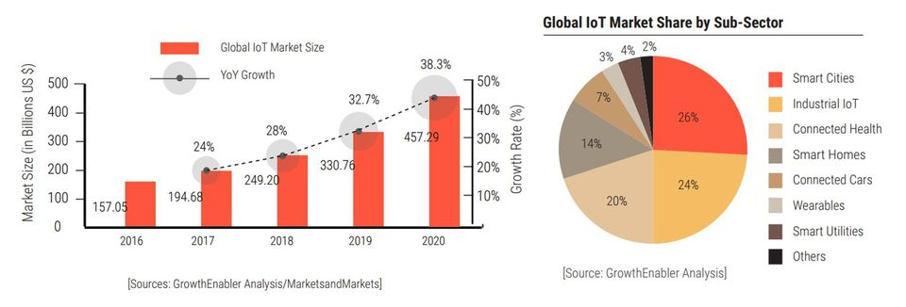
IoT by Numbers - Global
source

Slide 7
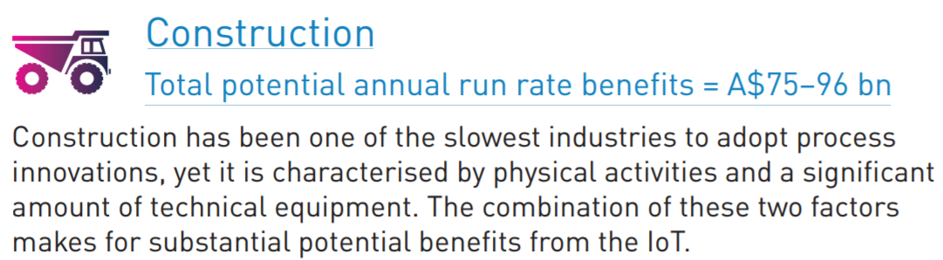
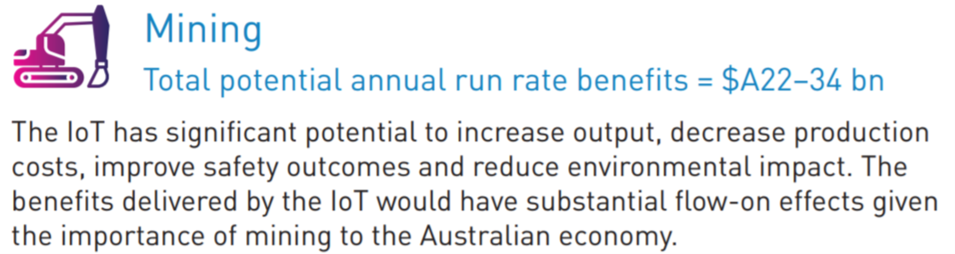
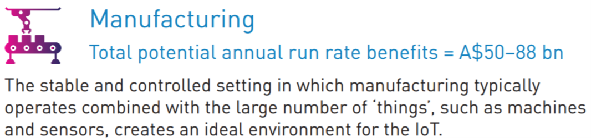
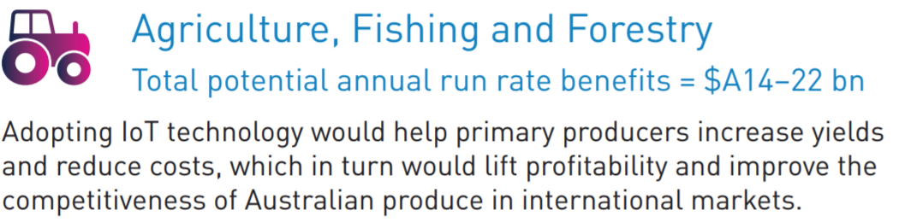
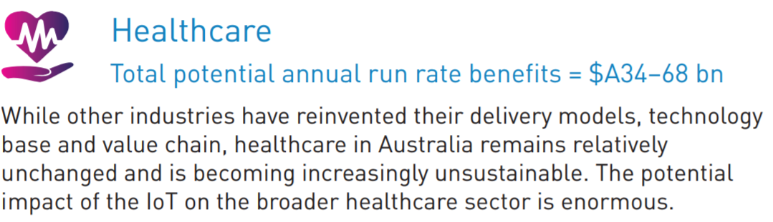
IoT by Numbers - Australia (An ACS Report)
Across the five industries assessed, which represent 25% of Australia’s GDP, the IoT can achieve potential annual benefits of A$194–308 bn over a period of 8–18 years. This impact translates into average productivity improvements of around 2% p.a. across these industries.
source

Slide 8


Slide 9


IOT & INTELLIGENT INFRASTRUCTURE
Transportation, Traffic, Parking, Vehicles
Social
Municipal Command & Control Center
Factory Optimization
Economy
Environment
Housing,
Buildings
Smart Grid
Logistics Optimization
Connected CITY
Responsive Store
Building Optimization
Traffic Flow Optimization
Energy, Water & Utilities
Home Energy Management
Connected FACTORY
Comms Network Optimization
Citizen Engagement
Connected
BUILDING
Connected HIGHWAY
Connected GRID
Public Safety & Security
Intelligent Supply Chain Devices
Connected VEHICLE
Traffic Sensors & Cameras
Connected Fleet
Digital Signage
Automated Car System

Slide 10

Agriculture and Wearables

Slide 11

CSIRO Bees Tracking

Slide 12
A SIMPLE VIEW OF AN IOT SOLUTION
Things
Insights
Actions

Slide 13
A MORE REALISTIC VIEW…
Enterprise integration
Cloud-to-device commands
Business process integration
Cold path analytics
Device recovery
Solution scale
Operations monitoring
Cost management
Internationalization
High availability
Updating devices
Provisioning devices
Device lifecycle
Transport protocols
Warm path analytics
Drivers
Things
Disaster recovery
Insights
Hot path analytics
Actions
Device updates
Data storage
< ---- End-to-End Security ---- >
Data ownership
On device analytics
Data visualization
HW certification
Manufacturing scale
Industry and government compliance
Device commercialization
Deployment
Securing data
Fault tolerance
… and why IoT needs simplifying

Slide 14
Comprehensive Set of Capabilities for IoT Solutions
Azure IoT Central
IoT SaaS
SaaS
Solutions
Azure IoT solution accelerators
PaaS
remote monitoring
predictive maintenance
connected factory
device simulation
Device Support
Edge Support
IoT Services
Data & Analytics Services
Visualization & Integration Services
Azure IoT Device SDK
Azure IoT Edge
Azure IoT Hub
Azure Stream Analytics
Azure HD Insight
Microsoft Flow
Microsoft Power BI
Services
PaaS Services &
Device Support
Certified Devices
Azure Certified for IoT
Azure Digital Twins
Azure Time Series Insights
Azure Event Hubs
Azure Logic Apps
Azure Active Directory
Security Program for Azure IoT
Azure IoT Hub Device Provisioning Service
Azure Machine Learning
Azure Data Lake Analytics
Notification Hubs
Azure Monitor
Windows 10 IoT Core
Cosmos DB
Azure Data Lake
Azure Websites

Slide 15
Azure IoT reference architecture
Core Subsystems
UI & Reporting Tools
Visualize data and learnings
IoT Devices
Provision and send data from device to cloud
Cloud Gateway (IoT Hub)
Stream Processing
Business Integration
Stream processing and rules evaluation over data
Device Management
Storage
Store data
Integrate with business processes
Things
Insights
Actions
Notes:
Speaker notes:
At the core an IoT application consists of the following subsystems: 1) devices (and/or on premise edge gateways) that have the ability to securely register with the cloud, and connectivity options for sending and receiving data with the cloud, 2) a cloud gateway service, or hub, to securely accept that data and provide device management capabilities, 3) stream processors that consume that data, integrate with business processes, and place the data into storage, and 4) a user interface to visualize telemetry data and facilitate device management.

Slide 16

Establish bi-directional communication with billions of IoT devices
Enhance security with per device authentication
Azure IoT Hub
Provision devices at scale w/IoT Hub Device Provisioning Service
Manage devices at scale with device management
Multi-language and open source SDKs

Slide 17
Azure IoT Hub
Bi-directional communication
Millions of Devices
Multi-language, open source SDKs
HTTPS/AMQPS/MQTTS
Send Telemetry
Receive Commands
Device Management
Device Twins
Queries & Jobs
Enterprise scale & integration
Billions of messages
Scale up and down
Declarative Message Routes
File Upload
WebSockets & Multiplexing
Azure Monitor
Azure Resource Health
Configuration Management
End-to-end security
Per Device Certificates
Per Device Enable/Disable
TLS Security
X.509 Support
IP Whitelisting/Blacklisting
Shared Access Polices
Firmware/Software Updates

Slide 18
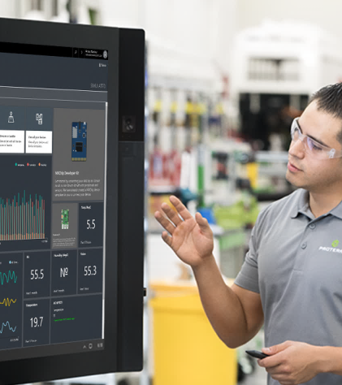
Fully hosted and managed by Microsoft
No cloud development expertise required
Device connectivity and management
Azure IoT Central
Monitoring rules and triggered actions
User roles and permissions
Analytics, dashboards and visualization
Risk-free trial with simplified pricing
Notes:
Reduces the complexity of IoT solutions with a ully managed SaaS offering for customers and partners that enables powerful IoT scenarios without requiring cloud solution expertise.
Simplifies the development process and makes it easy and fast for customers to get started, making digital transformation more accessible to everyone.
Available along with our existing platform-as-a-service (PaaS) solution, Azure IoT Suite, which enables deep customization and full control.

Slide 19
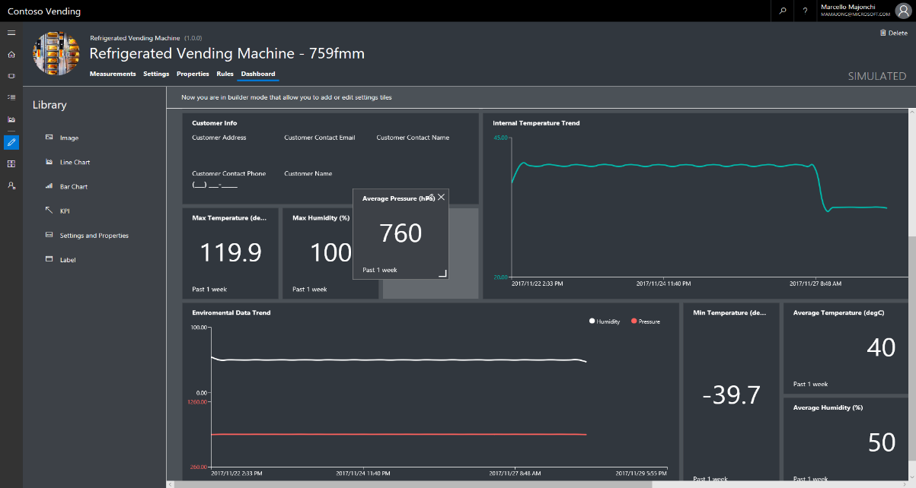
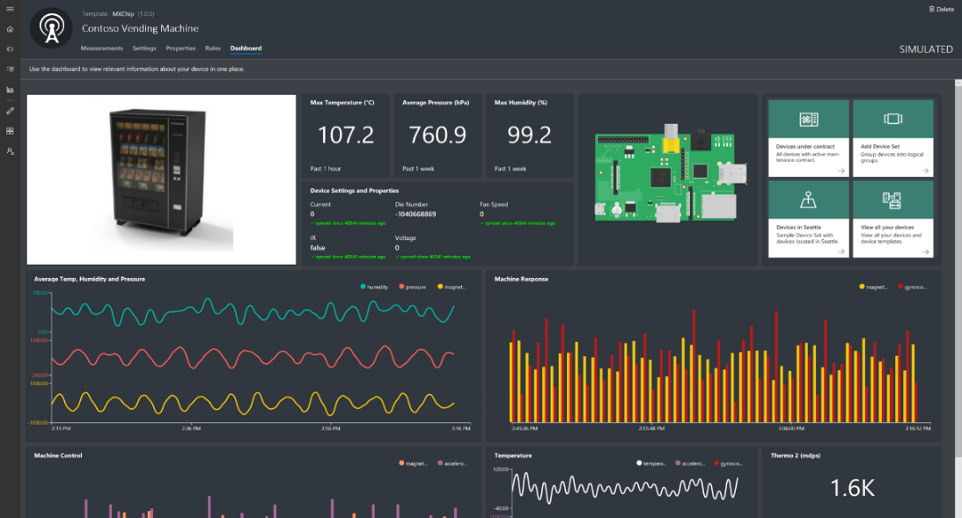
Builder
Operator
Product modeler
Device management
Device settings
Analytics & dashboards
Template management
Time-series Insights
Rules workflows
Alerts and actions
User and identity management

Slide 20
DIGITAL TWINS: FUSING PHYSICAL AND DIGITAL
PHYSICAL WORLD
Data
Control
Data
Control
High scale, richer, more innovative business results
S
P
A
C
E
S
L
E
Context
Data
Control
O
P
P
E
System
Intent,
Context
Assistance, Task completion
Process
D
E
V
I
C
E
S
Insight, optimization
Artificial Intelligence
Measure
DIGITAL WORLD
Quantified Self
Insight, optimization
Measure
Quantified Organization
Notes:
http://www.zdnet.com/emerging-tech-is-transforming-the-workplace-7000028960/

Slide 21




GROWING INTEREST IN SMART SPACES
Market Forces
Sustainability initiatives | Workplace trends
Pressure to minimize costs | Lease accounting rules
Audiences
Owners
Operators
Occupants
Scenarios
Energy
Space
Productivity
Partners
Building Infrastructure
Facility Management
Workplace Experience
Notes:
BEYOND BMS, BAS, BIM, IWMS… Integrated workplace management system
Sustainability initiatives: Corporate initiatives to reduce energy consumption and manage energy costs
Pressure to minimize costs: Companies are looking to reduce costs associated with operating real estate assets
Workplace trends: Shared and open workspaces require new approaches to building design and productivity features
Lease accounting rules: Compliance and reporting of leased space on companies’ financial statements/balance sheets
https://www.marketwatch.com/story/this-next-accounting-rule-change-will-add-liabilities-to-every-balance-sheet-2018-04-24
In filings with the Securities and Exchange Commission for the quarter ended Dec 31, 2017, JPMorgan Chase Inc. said that the balance sheet impact would be $10 billion, Capital One Financial Corp. said it would be 2.7 billion and Apple Inc. put the number at $9.6 billion, according to data compiled by research firm Audit Analytics. In all of these cases, the addition of the liabilities would have a material impact on the financial statements of these companies beginning in January 2019.

Slide 22
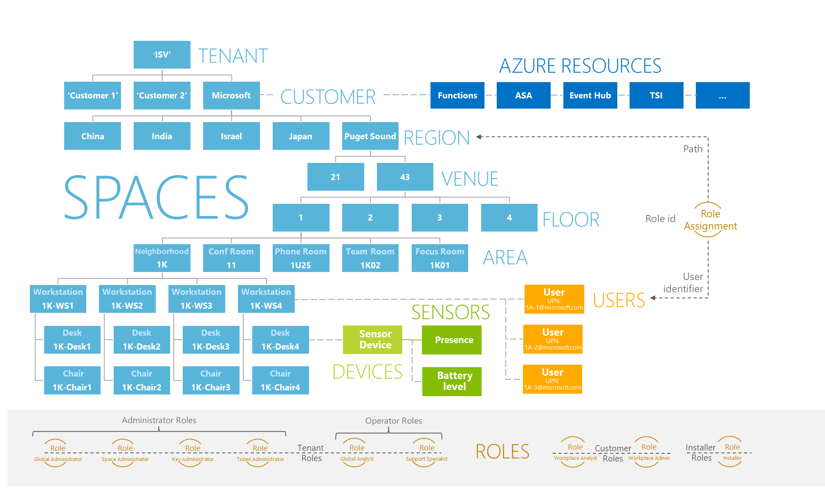
Example Smart Space Ontology
Notes:
Ontology: a set of concepts and categories in a subject area or domain that shows their properties and the relations between them.
Example could be workplace optimization = smart spaces
Digital Twins object models describe domain-specific concepts, categories, and properties. Models are predefined by users who want to tailor the solution to their specific needs. Together, these predefined Digital Twins object models make up an ontology. A smart building's ontology describes regions, venues, floors, offices, zones, conference rooms, and focus rooms. An energy grid ontology describes various power stations, substations, energy resources, and customers. With Digital Twins object models and ontologies, diverse scenarios and needs can be customized.

Slide 23
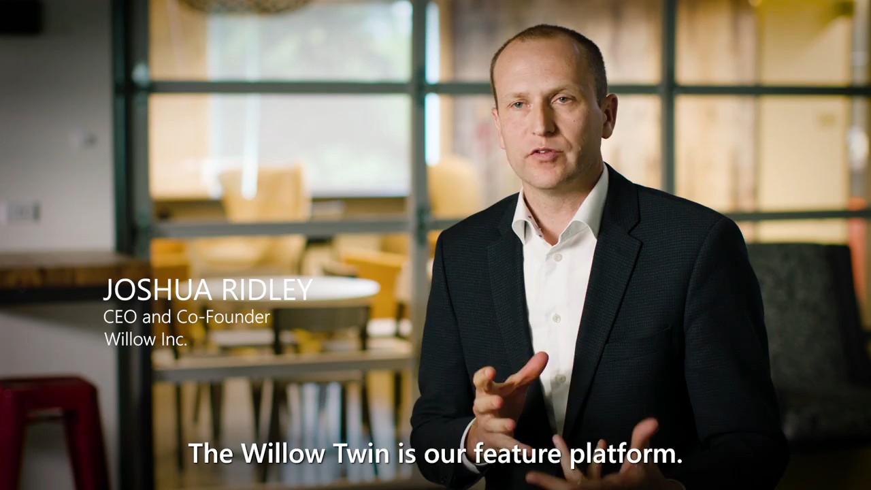

Slide 24
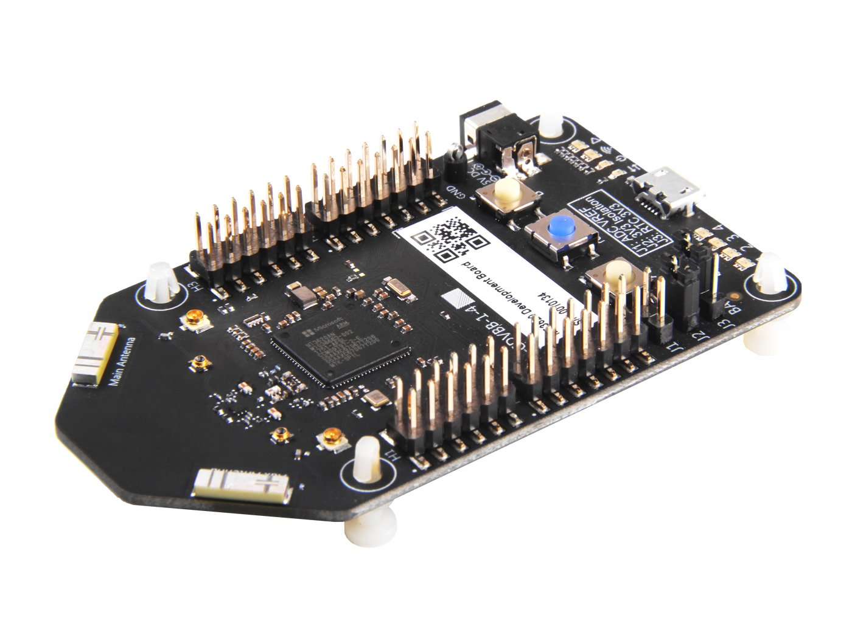
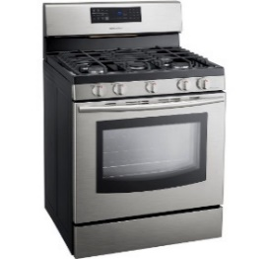
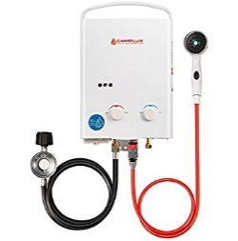
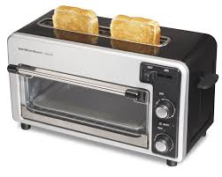
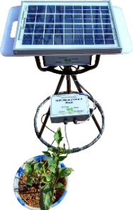
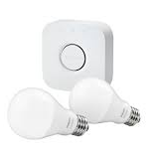
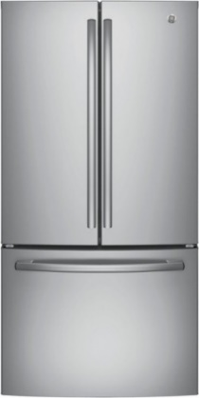
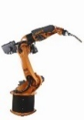
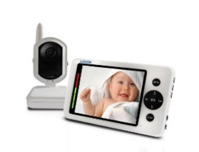
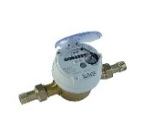
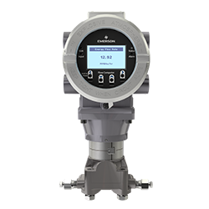

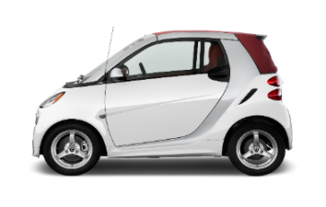
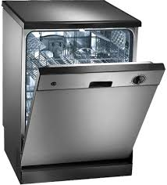
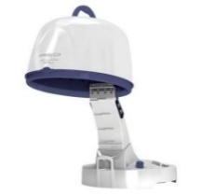
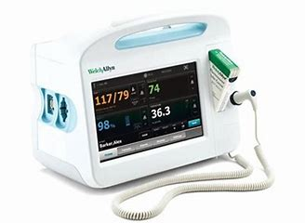
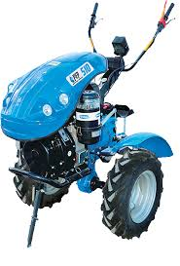
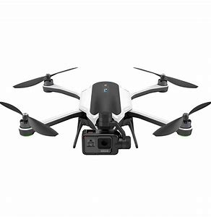
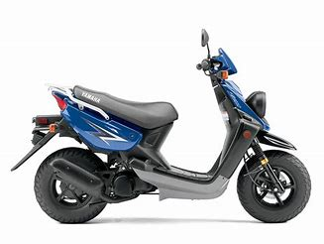
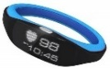
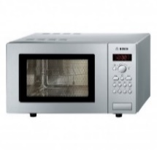
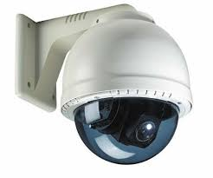
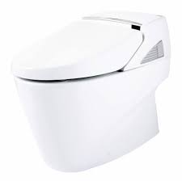
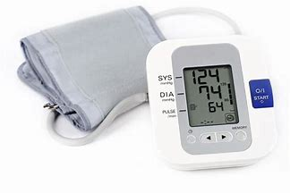
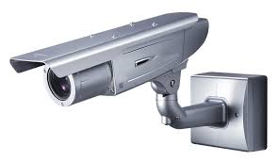

Azure Sphere - highly-secure, connected, MCUs
A new Azure Sphere OS secured by Microsoft for the devices 10-year lifetime to create a trustworthy platform for new IoT experiences
A new Azure Sphere class of MCUs, from silicon partners, with built-in Microsoft security technology provide connectivity and a dependable hardware root of trust
The Azure Sphere Security Service guards every Azure Sphere device; it brokers trust for device-to-device and device-to-cloud communication, detects emerging threats, and renews device security
Notes:
Azure Time Series Insights is a fully managed analytics, storage, and visualization service that makes it incredibly simple to explore and analyze billions of events simultaneously.
Time series data represents how an asset or process changes over time
Time series data has a timestamp and time most meaningful as an axis
Storing, indexing, querying, analyzing, and visualizing is challenging
IIoT exponentially generating more time series data

Slide 25
Hands-on Lab Azure IoT Central
https://bit.ly/2Q43vHQ

Slide 26

Move cloud and custom workloads to the edge, securely
Seamless deployment of AI and advanced analytics
Configure, update and monitor from the cloud
Azure IoT Edge
Compatible with popular operating systems
Code symmetry between cloud and edge for easy development and testing
Secure solution from chipset to cloud

Slide 27
Azure IoT Hub in the Cloud and on the Edge
Azure IoT Hub in the Cloud
Internet Scale Device Support
Remote monitoring and management
Infinite Compute and Storage for Workloads such a Machine Learning & LOB
Azure IoT Edge
Low latency requiring near real-time response
Large quantities of data eg Image processing
Protocol translation & data normalization

Slide 28
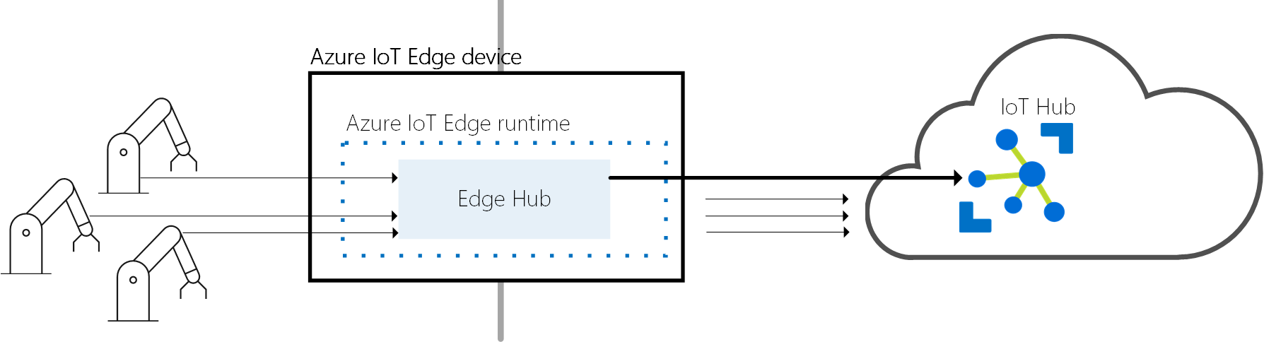
Azure IoT Edge Design Principles
Extends Azure IoT Hub to the Edge
End to End Security (with TPM)
Central Health Monitoring & Reporting
Application Life Cycle Management
Local & Cloud Message Services
Store and Forward & Gateway Services
Linux and Windows Support
Open Source Runtime (MIT)

Slide 29

Azure IoT Edge Development
Cross-platform
Develop on Windows, Mac and Linux with Visual Studio Code
SDKs for C#, Python, Java, and Node.js
Target IoT Edge on Linux (x64 & ARM), Windows (x64)
Extensible
Your Custom Code
Microsoft 1st Party Modules - Azure Functions, Stream Analytics, Machine Learning
3rd Party Modules Marketplace
Unit of deployment is a Docker Image
Azure Container Registry, Docker Hub
docker run -d -p 5000:5000 --restart=always --name registry registry:2
Notes:
29

Slide 30
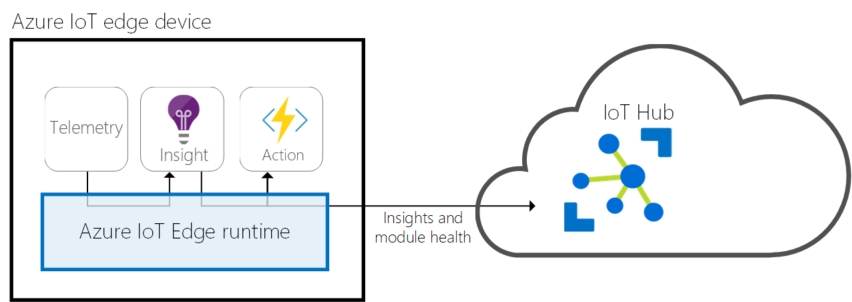
IoT Edge Runtime Concepts
Modules = Docker Containers
Device Twins = Reported & Desired State
Routes = define message paths

Slide 31
Concept - Routing
Edge Runtime
mod1
FROM <source> WHERE <condition> INTO <sink>
Sources – source of messages
/messages/modules/{mid}/outputs/{out1}
Condition – expression on messages properties/body
sensorType = “temp” and alert = true
Sinks – destination for messages (endpoints)
$upstream
brokeredEndpoint(“/modules/{mid}/inputs/{in1}”)
For example:
FROM /messages/modules/mod1/outputs/*
WHERE sensorType = “temp”
INTO brokeredEndpoint(“/modules/mod2/inputs/in1”)
inputs/in1
outputs/out1
mod2
inputs/in1
outputs/out1
$upstream
Query Language

Slide 32

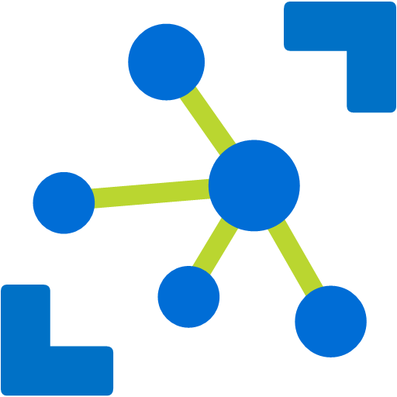
Concept – Device Management
Query
Power plant
IoT Edge or device
Device twin
Device twin
Elevators
Desired
Desired
Reported
Reported
Smart meters
Tags
Methods
IoT Hub
Methods
Medical devices
Jobs
Buildings
Schedule and broadcast Device twin changes across large fleets
Notes:
The following is a high-level illustration of how a firmware update pattern is performed leveraging IoT Hub.
The back end application initiates the firmware update (using a method call). The FW update handler app on the devices returns a response that the update command was received.
**SPEAK TO** If updating many devices, a job can be used to schedule the update process for many devices at a particular time.
The FW update handler downloads the firmware image from the URI provided by the method call. It reports completion of this step by updating the device twin.
The back end application dash board sends a query to the twin and updates to show the FW image was successfully downloaded to the device.
The FW update handler begins the firmware update process and reports this by updating the device twin.
The back end application dashboard sends a query to the twin and updates to show the FW update process has begun.
The FW update handler completes the FW update & reboot, reconnects to IoT Hub, and updates a the device twin to indicate the process has been completed.

Slide 33






Azure IoT Edge in Action
Develop your Container Workloads
Upload Modules to a Container Registry
Provision IoT Edge Device Agents
Select Device/Deployment Set
Define Modules
Define Message Routes
Define Module Parameters
Container Registry
Azure IoT Hub
IoT Edge
Container
Module
Container
Module
Container
Module
Container
Module
Module Twin
Device Twin
Module
Routes
Edge runtime
Local storage
Device Provisioning
Security Manager
Secure Boot
Secure Storage
Hardware based root of trust

Slide 34
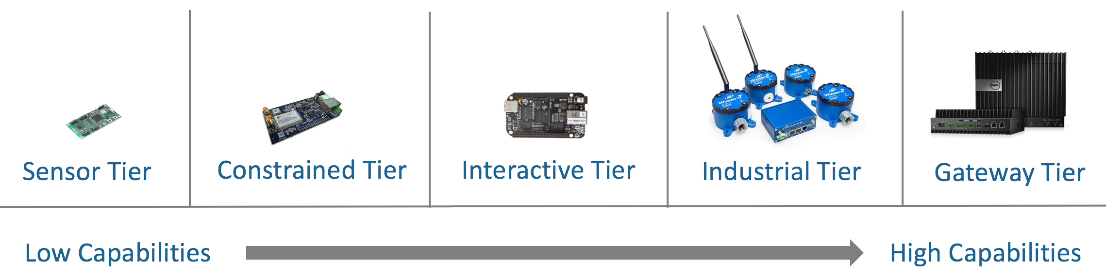
Hardware for Azure IoT Edge
Linux and Windows supported on x64 and ARM (support for containers required)
Hardware sizing dependent on workloads
Internal tests on devices as small as Raspberry Pi 3 with four containers (on Linux)
Notes:
34

Slide 35
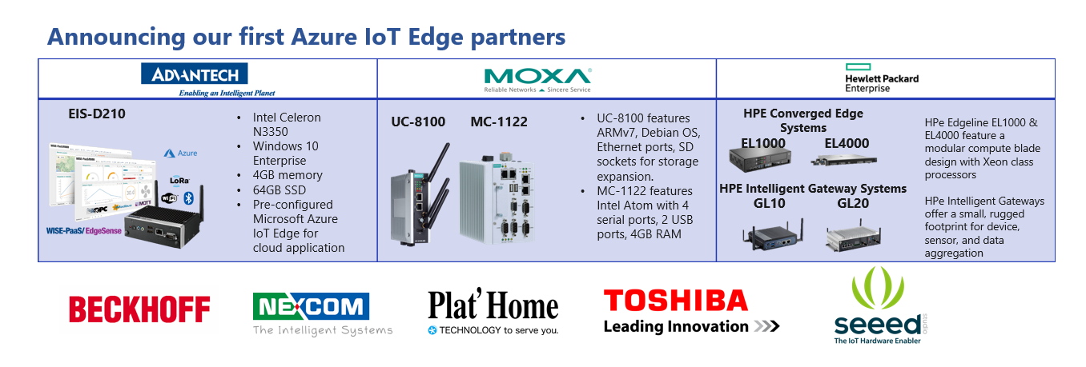
Certified hardware for Azure IoT Edge
Azure IoT Edge certification requirements
Core requirements for functional areas: AI, Device Management, and Security
Additional functional areas to be added
HW partners and OEMs welcome to join
Send email to iotcertdisc@microsoft.com
catalog.azureiotsuite.com
Notes:
New certification framework:
Each block = capability has its own requirements and N # of levels
MSFT can continue to add certifications for capabilities as necessary
Update cadence will align with each semester
Edge runtime: Level 1 only
AI capability: Level 1 or 2
Device Management capability: Level 1 only
Security capability: Level 1-4
35

Slide 36
Azure IoT Edge Development Cognitive Services Vision
Azure Container Registry
Azure
IoT Hub
Custom
Code
(video collection)
Azure Cognitive Services
Azure Speech Servces
IoT Edge
Device
(Raspberry Pi)
Deployment Manifest
Docker
Container
Docker
Container
Docker
Container
Video Camera

Slide 37
Demo: Retail for Visual Impaired People
Azure IoT Hub, Azure Custom Vision, Bing Speech, Visual Studio Code

Slide 38
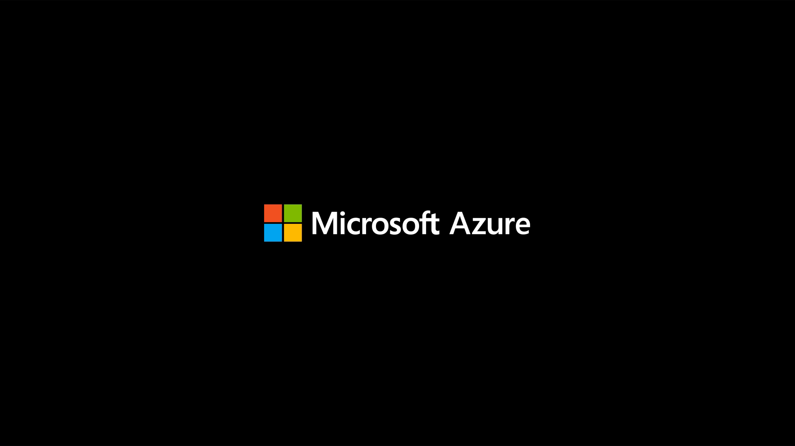


Slide 39
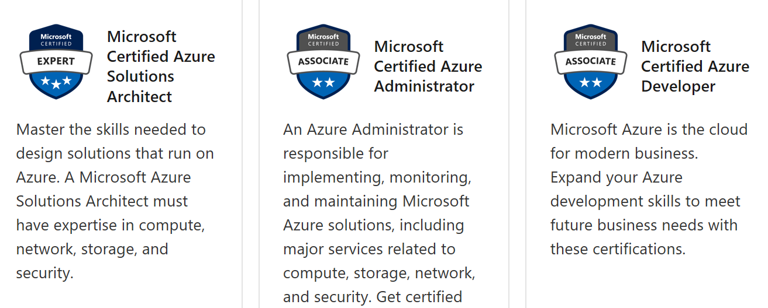
Stay Tuned for New Certifications

Slide 40
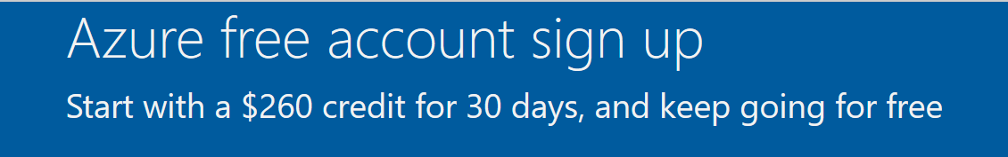
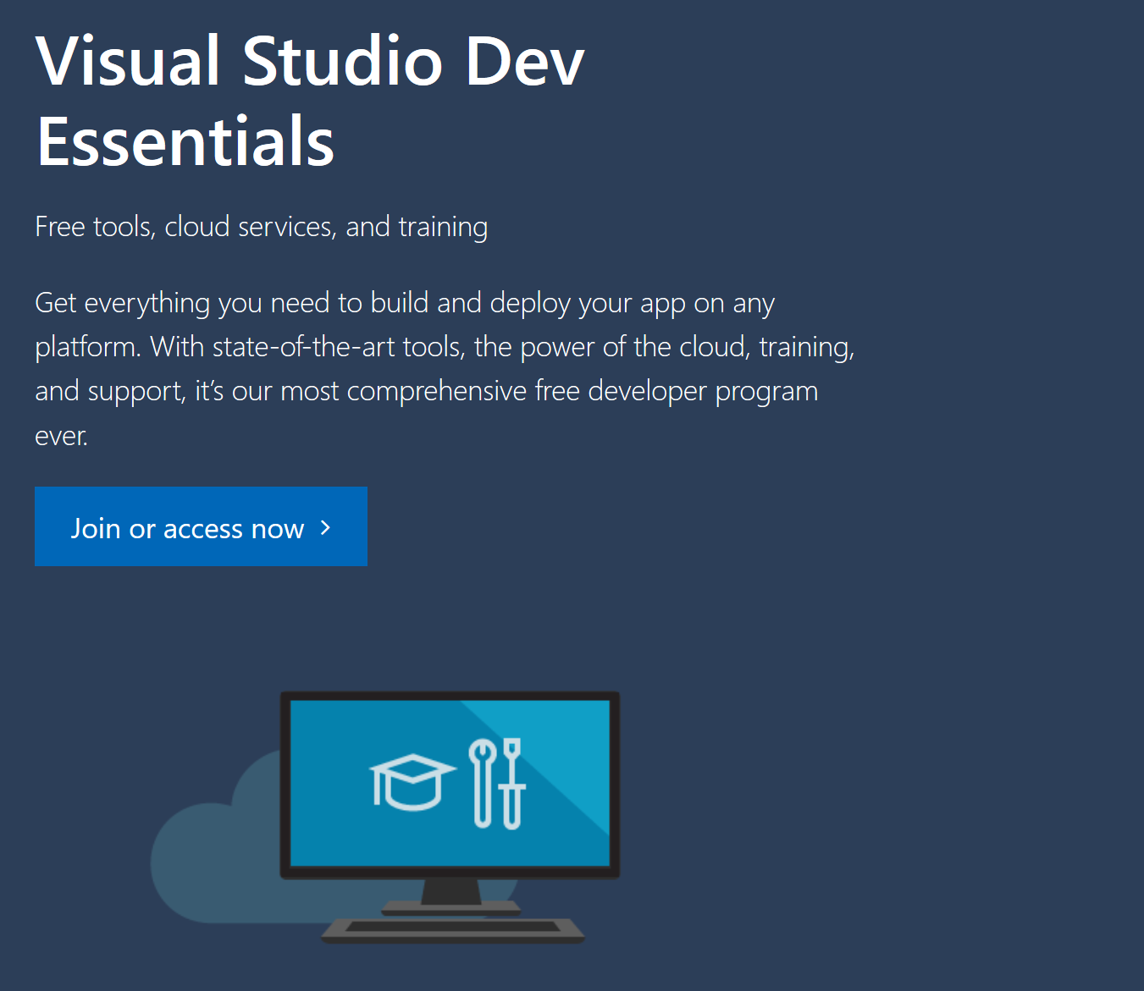
https://azure.microsoft.com/en-au/free https://visualstudio.microsoft.com/dev-essentials/ Comprehensive set of cloud services Free access to cloud services such as compute and storage, backend services for your mobile or web apps, services for IoT, machine learning, and analytics. Azure free account (includes 1 yr of free services, $200 for 1st month) Azure DevOps account with five users Visual Studio App Center App Service free tier Application Insights free tier
Microsoft Azure Offers

Slide 41
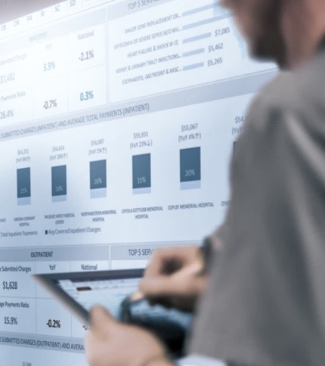
IoT scale time-series data store
Schema-less store, just send data
Azure Time Series Insights
Easy IoT Hub connection
Store, query, and visualize billions of events
Get near real-time insights in seconds
Build apps using Time Series Insights APIs
Notes:
Azure Time Series Insights is a fully managed analytics, storage, and visualization service that makes it incredibly simple to explore and analyze billions of events simultaneously.
Time series data represents how an asset or process changes over time
Time series data has a timestamp and time most meaningful as an axis
Storing, indexing, querying, analyzing, and visualizing is challenging
IIoT exponentially generating more time series data

Slide 42
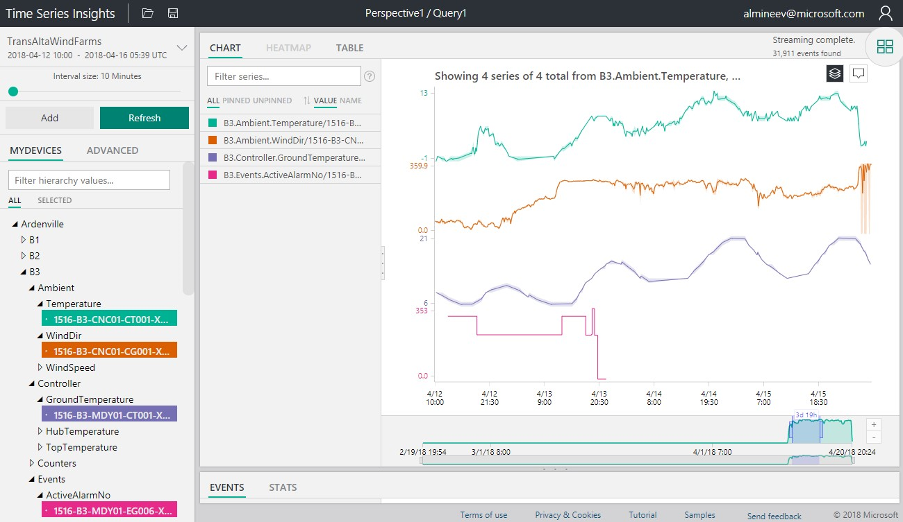
Azure Time Series Insights
New features coming!
“Tag-based” user experience that makes it easy to group time series data into logical “things” and hierarchies of “things”
Business reports with Power BI integration
Predictive analytics with Azure Machine Learning integration
Data analysis with Jupyter and Apache Zeppelin notebook integration
Advanced analytics with Azure Databricks, Apache Hadoop and Apache Spark integration

Slide 43
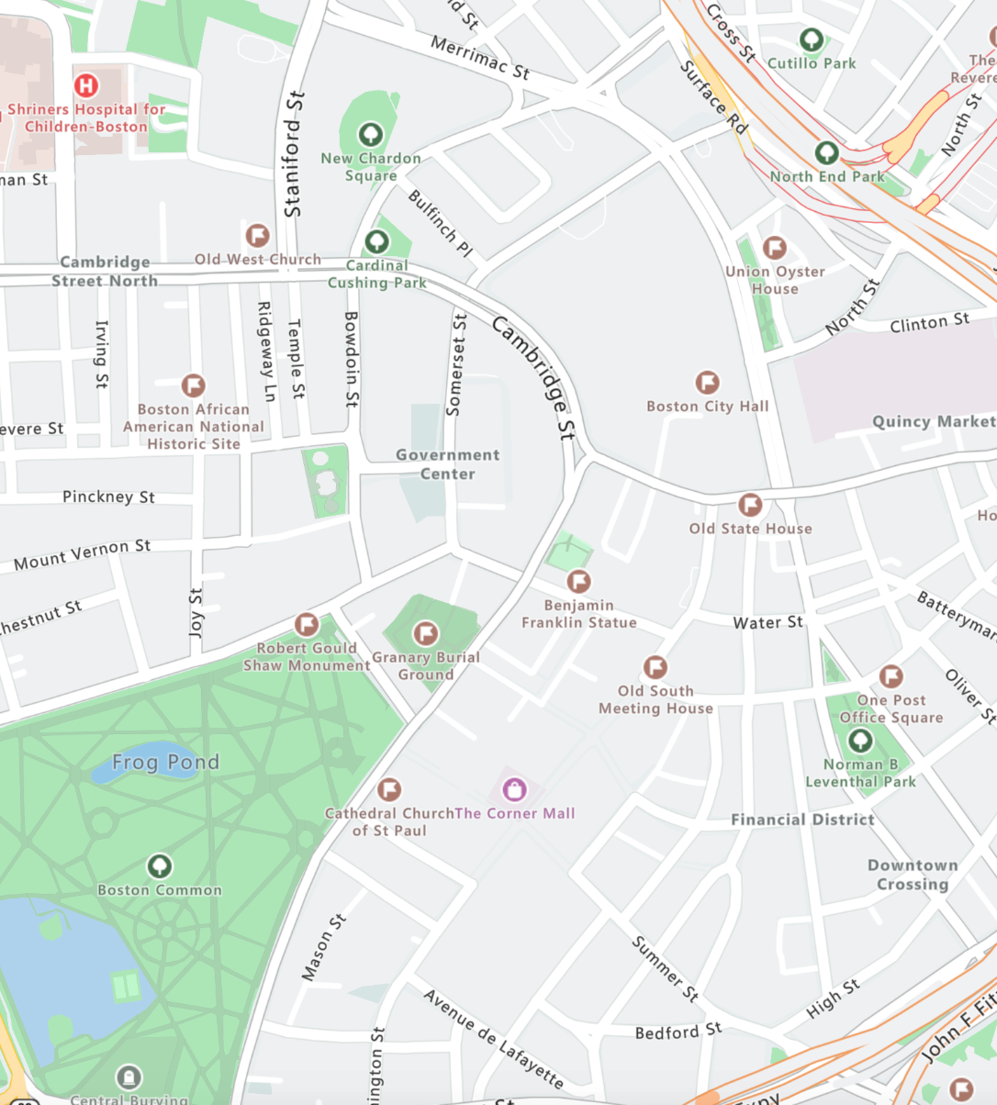
Azure IoT solution accelerators integration
Azure IoT Central integration in progress
Maps
Render maps and satellite imagery across many geographies
Map Control
Integrate rich mapping visualizations into applications
Azure Maps
Routing
Calculate routes from N to N points for optimal calculations
Search and Geocoding
Convert places and addresses to coordinates; or, convert coordinates to addresses or cross streets
Traffic
Show real time traffic information
Time Zones
Obtain time zone and current time information

Slide 44


Azure Maps
Location is at the heart of everything
Accurate, real time geospatial data is fundamental to the digital transformation of a wide range of industries and use cases, among them…
Mobility Solutions
Field Service
Automotive
Internet of Things (IoT)
Logistics
Web & Mobile Apps
Why use Azure Maps?
Key reasons for customers to opt for Azure Maps for their geospatial needs
In-vehicle use licensing rights
Unrivalled traffic data
and commercial routing
30+ languages supported
Integrated into Azure IoT
Custom data visualizations
Enterprise scale

